Slide 1
Intro text-image retrieval with mimic cxr

Slide 2
Goals / idea
A benchmark for free-text retrieval over large, unlabeled medical image datasets. Users query natural language descriptions, e.g., "chest X-ray with pneumonia" or "edema and pleural effusion" - and the system retrieves the most relevant images.
This addresses a real bottleneck: medical imaging datasets are often massive and unannotated, making it hard to locate specific findings without expensive manual labeling.

Slide 3
Phase 0: EDA

Slide 4
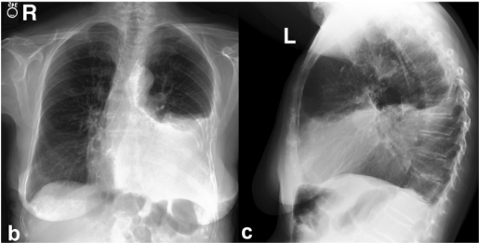
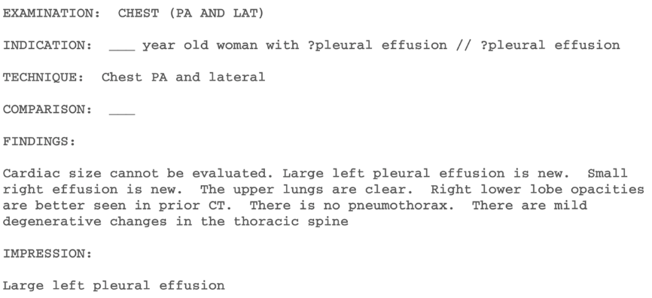
Our data – 360K examples
Atelectasis | Cardiomegaly | Consolidation | Edema | Enlarged Cardiomediastinum | Fracture | Lung Lesion | Lung Opacity | No Finding | Pleural Effusion | Pleural Other | Pneumonia | Pneumothorax | Support Devices
1 |  |  |  |  | -1 |  |  | 0 |  |  | -1
1: The label was positively mentioned in the associated study
0: The label was negatively mentioned in the associated study
-1: The label was either: mentioned with uncertainty/ambiguous language in the report
Missing: the label was not mentioned in the report
Notes:
Triplets

Slide 5
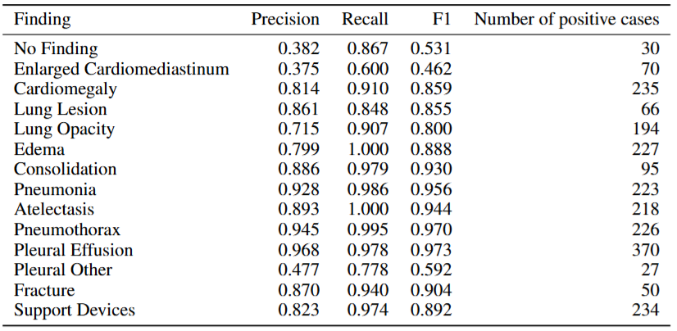
Labeling quality
A total of 687 reports were reviewed by a radiologis according to the 14 categories in CheXpert.

Slide 6
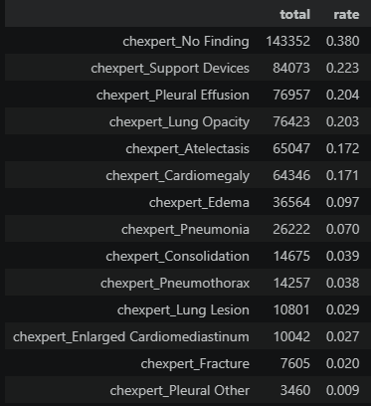
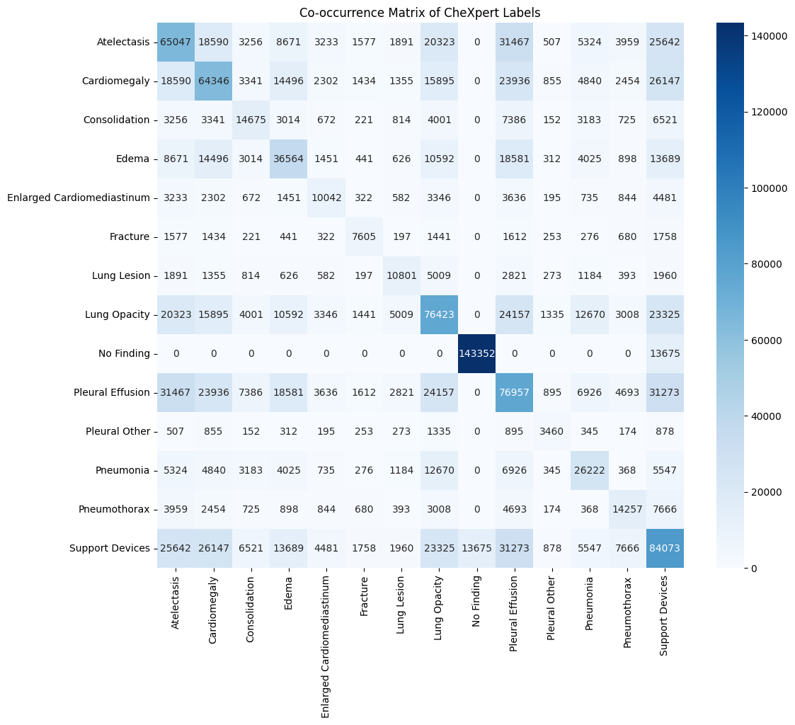
Dataset stats: labels frequency

Slide 7
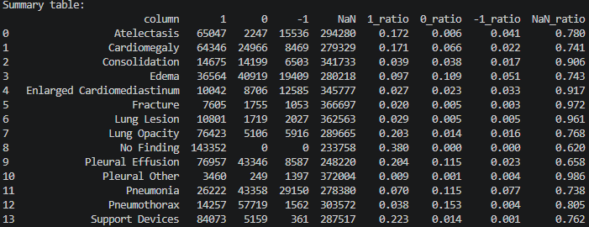
Counting distributions for CheXpert labels:

Slide 8
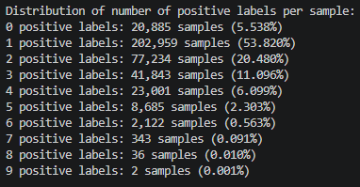

Slide 9
Phase 1: baseline evaluations

Slide 10
Metrics
P@K: of the top-k images the model retrieved, what fraction are actually relevant?
R@K: number of relevant retrieved items in top k / total number of relevant items in the dataset (Hard-capped at k/n_relevant).
Successful retrieval(per label): both the text and retrieved image have a shared categorical label.

Slide 11
Pipeline
Subset the dataset to size N (about 5000 that was used to test in a reference model, from the original 377K).
Embed all images with a clip based model.
Build queries.
Embed queries and their categorical label.
Find closest items with cosine similarity. Evaluate with metrics (from the previous slide).

Slide 12
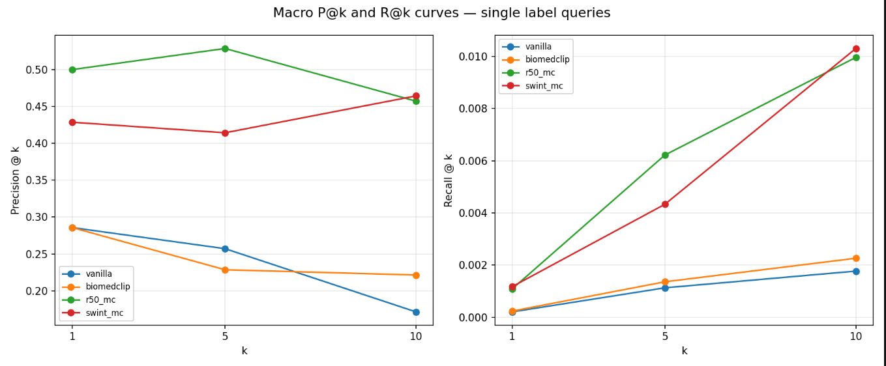
Results: average(across labels) P@k, R@k for different models

Slide 13
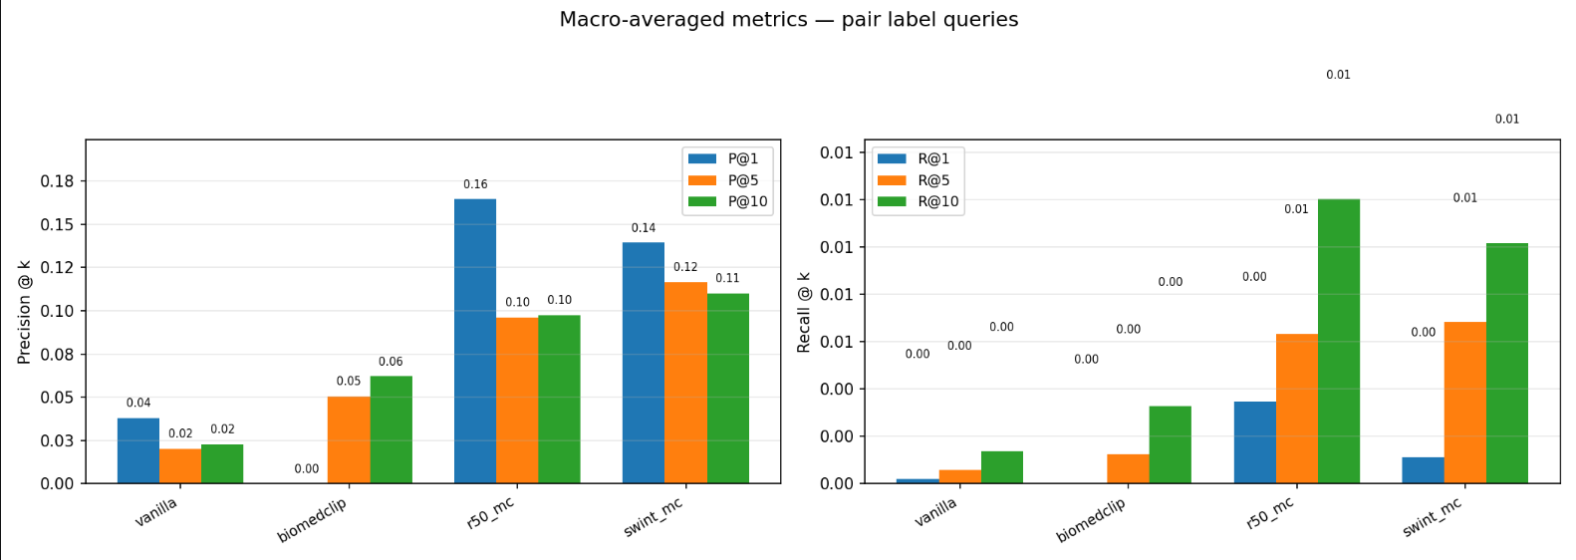
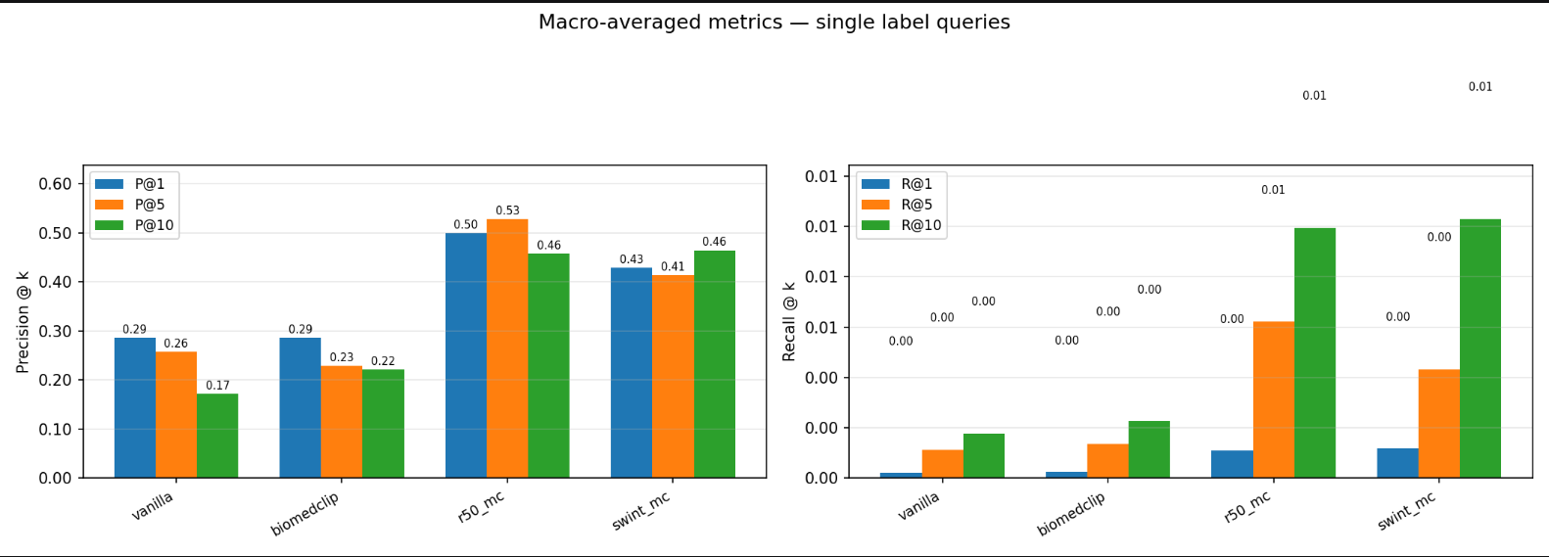

Slide 14
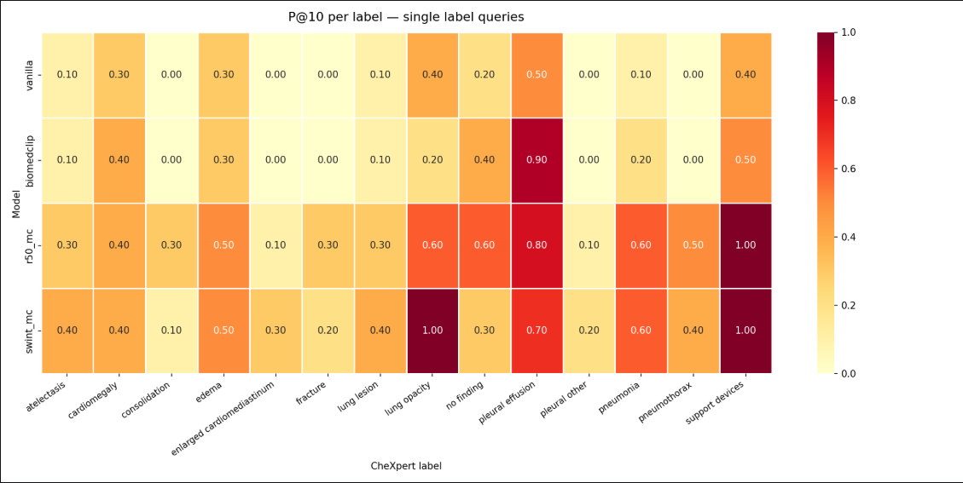

Slide 15
Phase 2: training

Slide 16
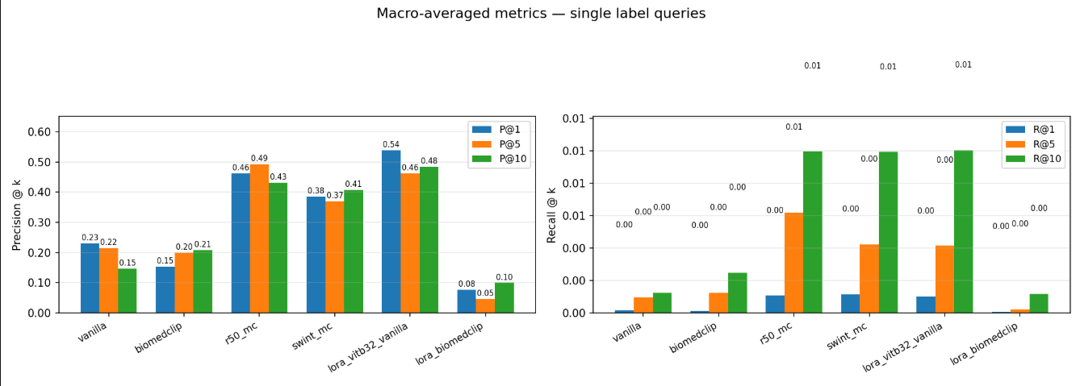
Single label: our fine tuned model slightly leads

Slide 17
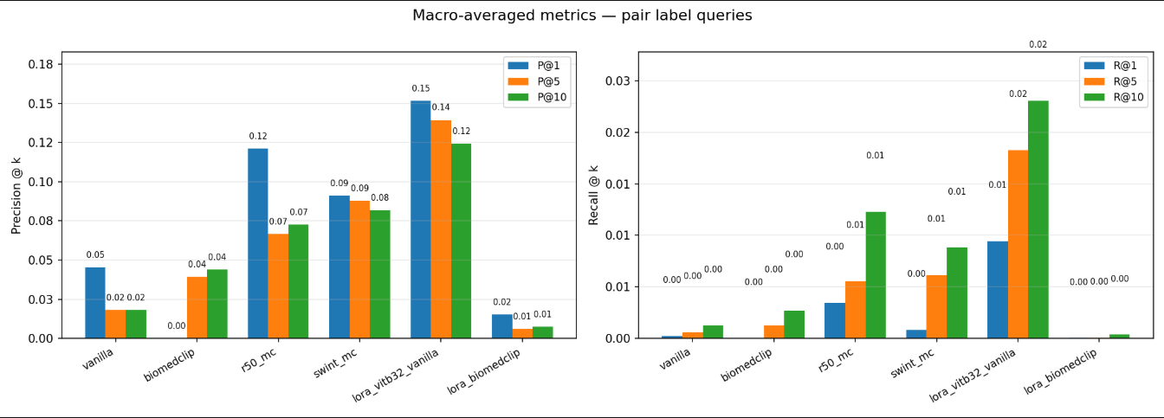
Pair label: our fine tuned model slightly leads

